Slide 1

Headless Pi
Work with a Raspberry Pi from your computer without a monitor, keyboard or mouse attached to the Pi

Slide 2
Agenda
Preparing
the OS Image
Connecting the FTDI Cable
Booting and Logging In
Configuring the Pi

Slide 3
Preparing the OS Image
Download the image for the Raspbian OS as a “.zip” from: https://www.raspberrypi.org/downloads/raspbian/
If you need an older version, checkout: http://downloads.raspberrypi.org/raspbian/images/
For example, the last version of Raspbian “Jessie” is at: .../images/raspbian-2017-07-05/2017-07-05-raspbian-jessie.zip
Download and install Etcher.io for your platform from https://etcher.io/
Insert the Micro-SD card for the pi into your computer
Use Etcher.io to flash the OS image “.zip” file to the SD card

Slide 4
Enable the UART on the Pi
With the newly flashed SD card still in your computer
Open the “config.txt” file at the root of the “boot” partition in the text editor of your choice
Add the following two lines to the bottom of the file: # Enable UART enable_uart=1
Save the changes to the “config.txt” file
Safely eject the SD car from your computer
Insert the SD Card into the SD Card slot on the Raspberry Pi

Slide 5
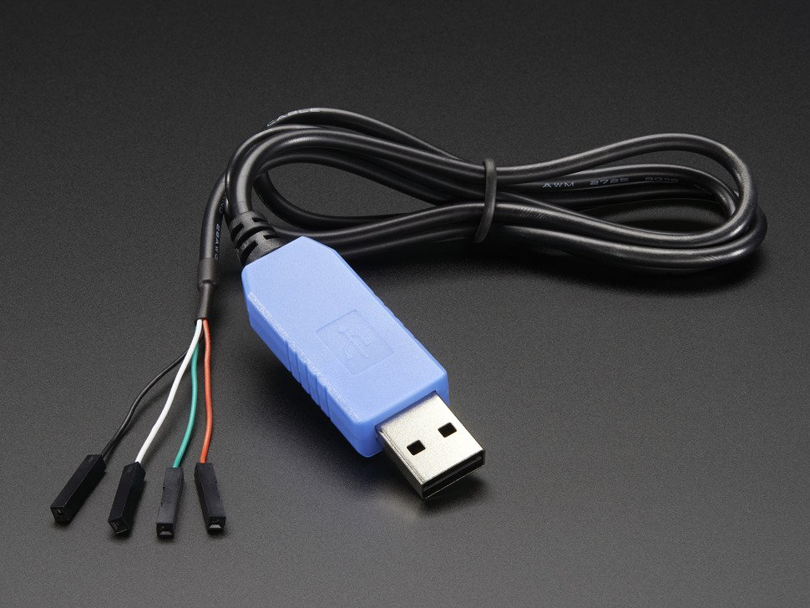
Get the Cable
https://www.adafruit.com/product/954

Slide 6
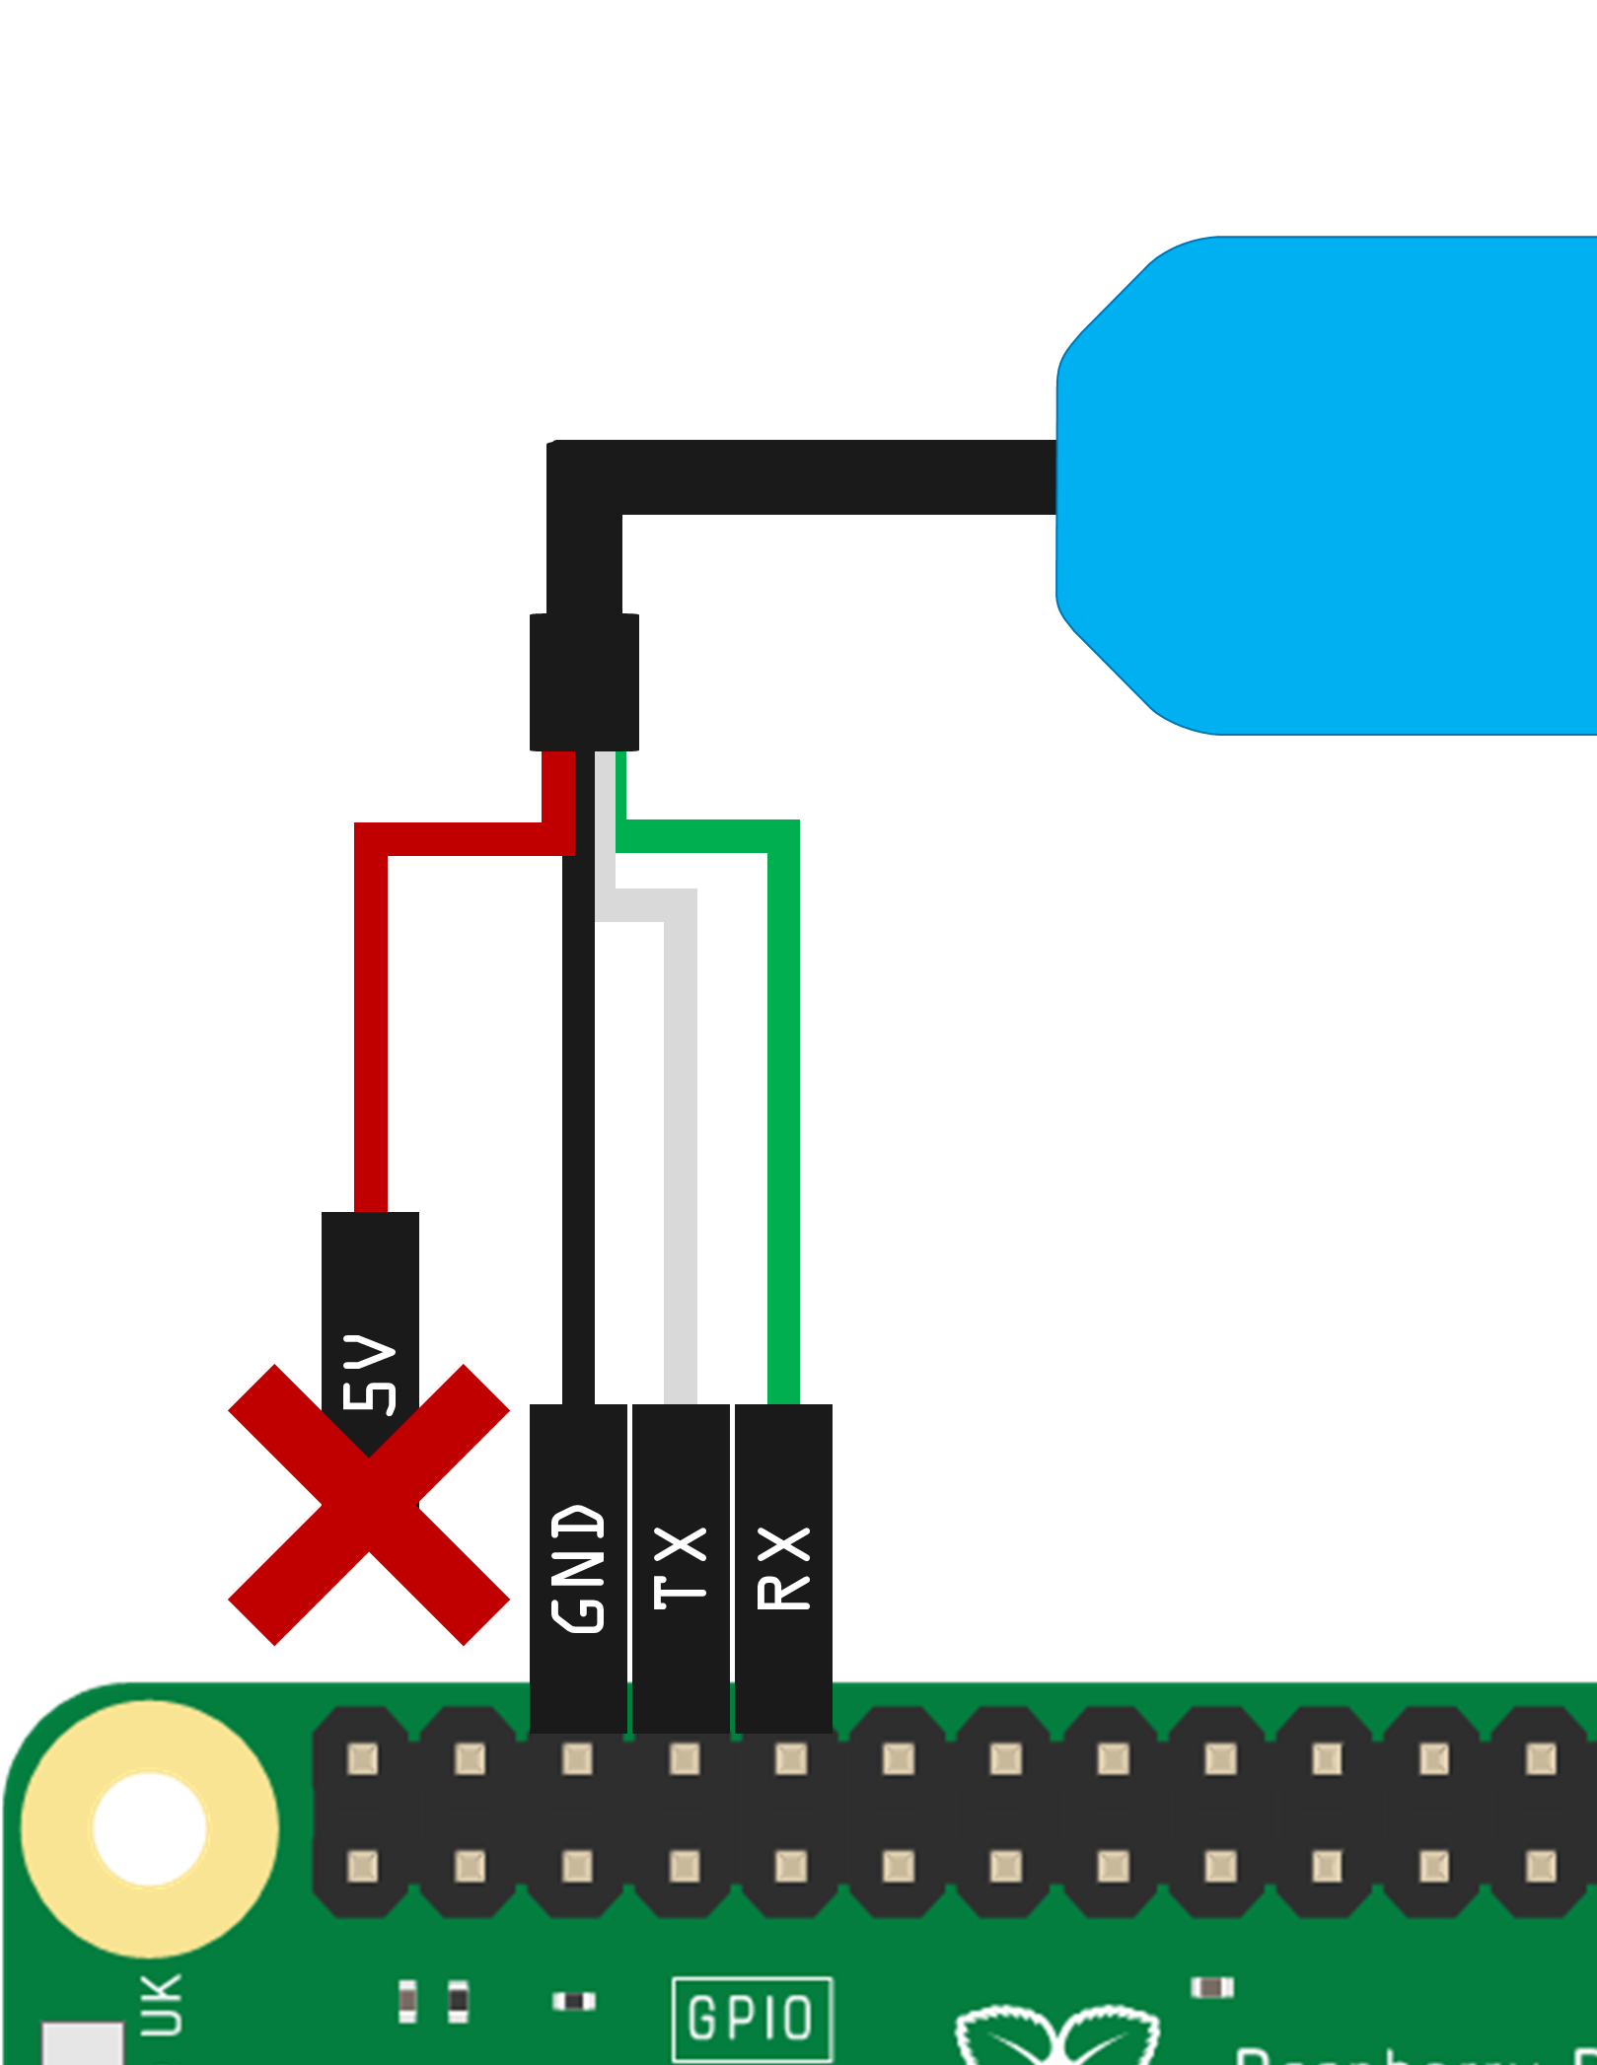
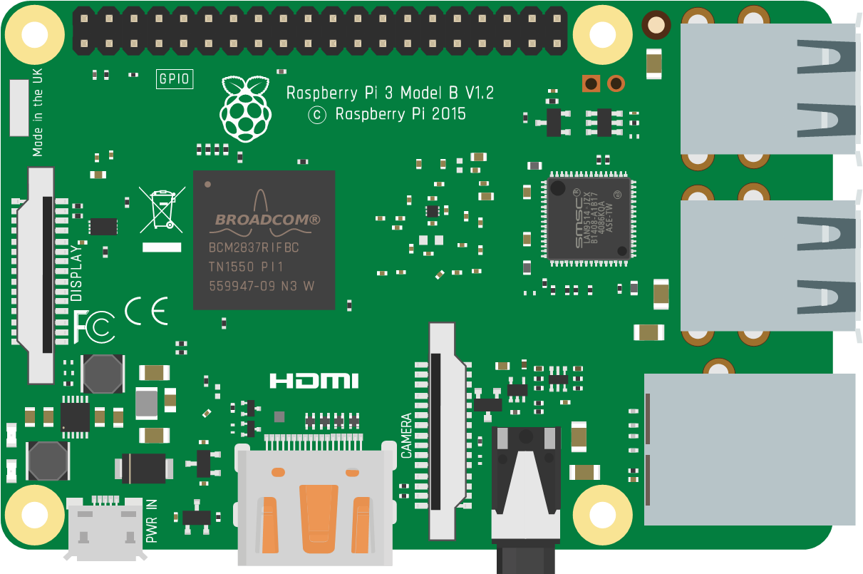
Connect the FTDI cable

Slide 7
Install the Drivers and Software
Windows: software-installation-windows
Mac: software-installation-mac
Linux: software-installation-linux

Slide 8
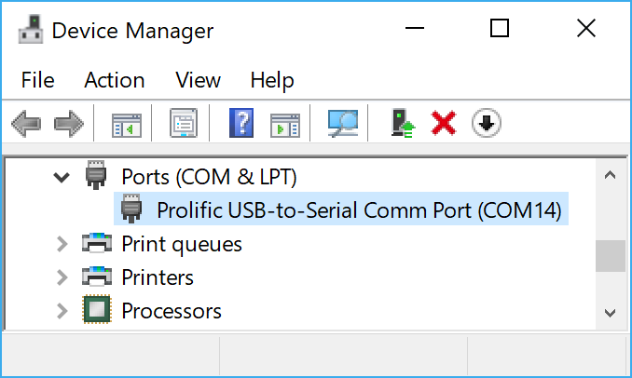
Determine the port for the FTDI Cable
Widows
macOS / Linux
Open Device Manager
Expand “Ports (COM & LPT)
Identify the Profilic COM Port
From a terminal prompt, run ls /dev/cu.*
Locate a device named similar to one of these: /dev/cu.usbserial-NNNN /dev/cu.SLAB_USBtoUART /dev/cu.usbmodem

Slide 9
Connect using Terminal Software
Windows
macOS / Linux
PuTTY
screen

Slide 10
Boot the Pi
Ensure the SD Card is in
Ensure the FTDI Cable is connected
Connect Ethernet if Available
Plug in the USB Power Supply
When prompted in the terminal window login: User name: pi Password: raspberry

Slide 11
Optional WiFi for Pi 2
Optional Ethernet

Slide 12
Optional WiFi Dongle for Pi 2
Optional Ethernet if desired

Slide 13
Boot the Pi
Ensure the SD Card is in
Ensure the FTDI Cable is connected
Connect Ethernet if Available
Plug in the USB Power Supply
When prompted in the terminal window login: User name: pi Password: raspberry

Slide 14
Enable SSH / VNC
sudo raspi-config nonint do_ssh 0
sudo raspi-config nonint do_vnc 0

Slide 15
Enable Camera, I2C and SPI
Optionally enable the Camera, I2C and SPI Interfaces
sudo raspi-config nonint do_camera 0
sudo raspi-config nonint do_i2c 0
sudo raspi-config nonint do_spi 0
You can alternatively run raspi_config interactively to set these options as well as many others.
sudo raspi-config

Slide 16
Configure WiFi with wpa_cli
sudo wpa_cli
> set country us (or your country code) > scan > scan_results (find network in list) > add_network (should add network 0) > set_network 0 ssid “your_network_ssid” > set_network 0 psk “your_network_preshared_key” or for an open network set_network 0 key_mgmt NONE > enable_network 0 > save_config > quit sudo cat /etc/wpa_supplicant/wpa_supplicant.conf (verify the config you specified above is written to the file)

Slide 17
Manually edit wpa_supplicant.conf
sudo nano /etc/wpa_supplicant/wpa_supplicant.conf Edit to match the following:
ctrl_interface=DIR=/var/run/wpa_supplicant GROUP=netdev
update_config=1
country=us
network={
ssid=“your_network_ssid"
psk=“your_network_preshared_key"
}

Slide 18
Open network wpa_supplicant.conf
sudo nano /etc/wpa_supplicant/wpa_supplicant.conf Edit to match the following:
ctrl_interface=DIR=/var/run/wpa_supplicant GROUP=netdev
update_config=1
country=us
network={
ssid=“your_network_ssid"
key_mgmt NONE
}

Slide 19
Manually Cycle the WiFi Interface
sudo ifdown wlan0 sudo ifup wlan0

Slide 20
Change your hostname
sudo nano /etc/hostname
Change name to something unique
Save the changes
sudo reboot
The pi should be broadcasting its name as “hostname.local” You should be able to ping it with “hostname.local” from your computer to get it’s IP address. (note, on windows, add -4 to your ping command to get it’s IPV4 address):
ping yourpishostname.local -4

Slide 21
Determine your Pi’s IP addresses
On the pi:
ip -4 a (-4 for IPV4 “a” short of “addr”)
Find Ips in output:
1: lo: <LOOPBACK,UP,LOWER_UP> mtu 65536 qdisc noqueue state UNKNOWN group default qlen 1
inet 127.0.0.1/8 scope host lo
valid_lft forever preferred_lft forever
2: eth0: <BROADCAST,MULTICAST,UP,LOWER_UP> mtu 1500 qdisc pfifo_fast state UP group default qlen 1000
inet 192.168.2.44/24 brd 192.168.2.255 scope global eth0
valid_lft forever preferred_lft forever
3: wlan0: <BROADCAST,MULTICAST,UP,LOWER_UP> mtu 1500 qdisc pfifo_fast state UP group default qlen 1000
inet 192.168.2.43/24 brd 192.168.2.255 scope global wlan0
valid_lft forever preferred_lft forever

Slide 22
Optionally configure ssh keys
Open bash on Windows, and run the following accepting all the defaults (including the empty passkey) ssh-keygen -t rsa -C "SSH Key for logging into the pi“
ssh into the pi with the password, and create the .ssh folder for the pi profile: #RUN THESE COMMANDS ON THE PI cd ~ install -d -m 700 ~/.ssh
Back on your computer, copy they key you created earlier like this, typing in the password one last time: # RUN THIS COMMAND IN BASH ON YOUR WINDOWNS LAPTOP cat ~/.ssh/id_rsa.pub | ssh pi@your.pi.ip.address 'cat >> .ssh/authorized_keys'

Slide 23
You can now ssh / vnc into the pi

Slide 24
Install and Configure SAMBA
sudo apt-get update
sudo apt-get upgrade
sudo apt-get install -y samba samba-common-bin
sudo mv /etc/samba/smb.conf /etc/samba/smb.conf.original
sudo nano /etc/samba/smb.conf REPLACE smb.conf file with contents from next slide sudo smbpasswd -a pi From a NON-ADMINISTRATIVE command prompt on your Windows PC, run: net use P: \\your.pi.ip.address\root /user:pi /persistent:yes Now you can open the “P:” drive on your windows pc to see the root of the Pi’s file system

Slide 25
smb.conf contents
[global] workgroup = WORKGROUP dns proxy = no log file = /var/log/samba/log.%m max log size = 1000 syslog = 0 panic action = /usr/share/samba/panic-action %d server role = standalone server passdb backend = tdbsam obey pam restrictions = yes unix password sync = yes passwd program = /usr/bin/passwd %u passwd chat = *Enter\snew\s*\spassword:* %n\n *Retype\snew\s*\spassword:* %n\n *password\supdated\ssuccessfully* . pam password change = yes map to guest = bad user usershare allow guests = yes [root] comment = root path=/ browseable=YES writeable=YES valid users= pi, root only guest=no create mask=0777 directory mask=07777 public=no force user = root

Slide 26
Install build tools
sudo apt-get install -y cmake build-essential curl libcurl4-openssl-dev libssl-dev uuid-dev python-dev python-smbus

Slide 27
Update git and install node 8.x
sudo apt-get install git curl -sL https://deb.nodesource.com/setup_8.x | sudo -E bash -
sudo apt-get install -y nodejs

Slide 28
Upgrade pip to v9
python -m pip install --upgrade pip

Slide 29
Install Azure IoT Device SDK for Python
pip install azure-iothub-device-client
https://github.com/Azure/azure-iot-sdk-python/blob/master/doc/python-devbox-setup.md#windows-wheels

Slide 30
Build the Azure IoT Hub SDK for Python
At a terminal prompt on the pi:
sudo apt-get install -y cmake build-essential curl libcurl4-openssl-dev libssl-dev uuid-dev python-dev python-smbus
cmake --version # (ensure version is at least 2.8.12)
gcc --version # (ensure version is at least 4.4.7)
python --version # (ensure 2.7, 3.4 or 3.5, note it for use below)
sudo apt-get update
cd ~
git clone https://github.com/Azure/azure-iot-sdk-python.git --recursive
cd azure-iot-sdk-python/build_all/linux
./setup.sh --python-version 2.7 # Replace the 2.7 with 3.4 or 3.5 as desired. Takes 2+ minutes depending on network speed
./build.sh --build-python 2.7 # Replace the 2.7 with 3.4 or 3.5 as desired. Takes 10-11+ minutes
# copy ~/azure-iot-sdk-python/device/samples/iothub_client.so to your python app folder for use.

Slide 31
Do a demo!

Slide 32
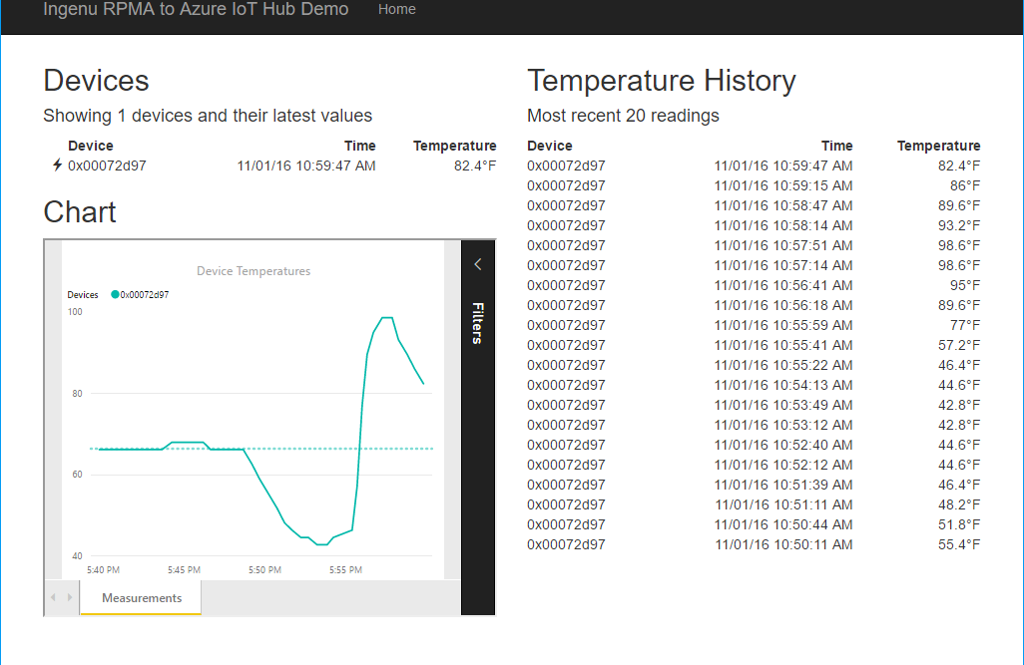


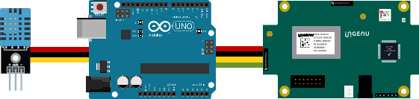
Resource Group <name>group
Power BI Embedded Collection ingenucollection
Power BI Embedded Workspace Dynamic GUID
RENDER
Power BI Report Temperature Chart
Storage Account ingenustorage
App Service Plan ingenuplan
READ/WRITE
Function App ingenufunctions
GET
Web App ingenuweb
QUERY
Function EventHub2IntellectRestJS
Function IntellectRest2IoTHubJs
QUERY
Service Bus Namespace ingenubus
SQL Server ingenusql
RECEIVE
SQL Database
ingenudb
Event Hub
ingenualerts
SEND
OUTPUT
OUTPUT
Stream Analytics Job ingenujob
POST
GET
AZURE
INPUT
RPMA to Azure
Architecture Diagram
IoT Hub ingenuhub
Ingenu Intellect Platform - REST or AMQP
INGENU
BACKHAUL
Ingenu RPMA Access Point
UPLINK
DOWNLINK
FIELD

Slide 33




Slide 34
IoT Logo

Slide 35
arduino

Slide 36
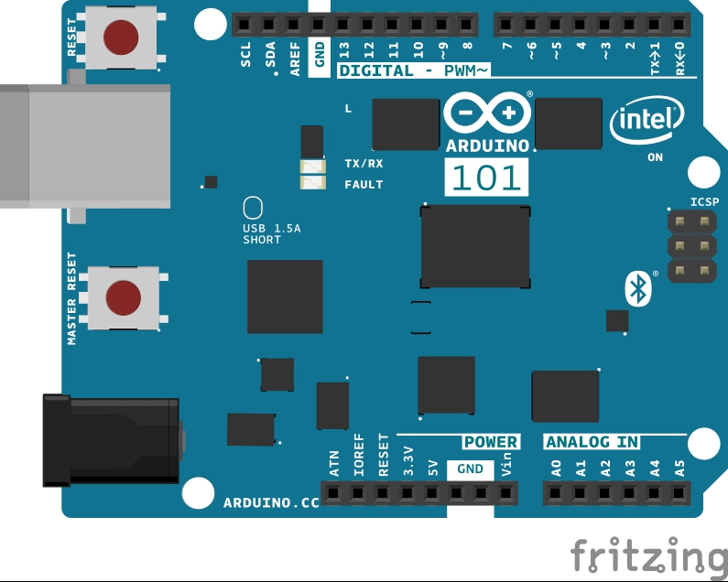
Arduino 101

Slide 37
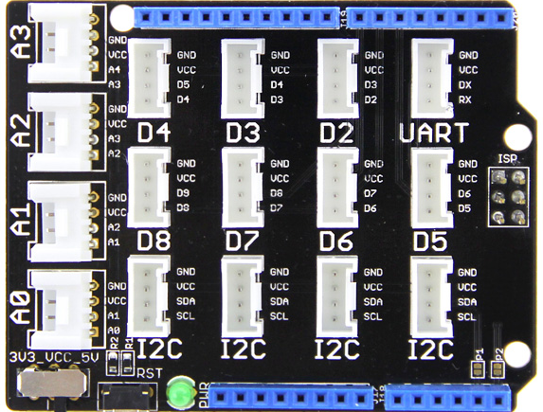
Grove Base Shield

Slide 38
Grove cable & SENSORS

Slide 39
Grove cable & SENSORS

Slide 40
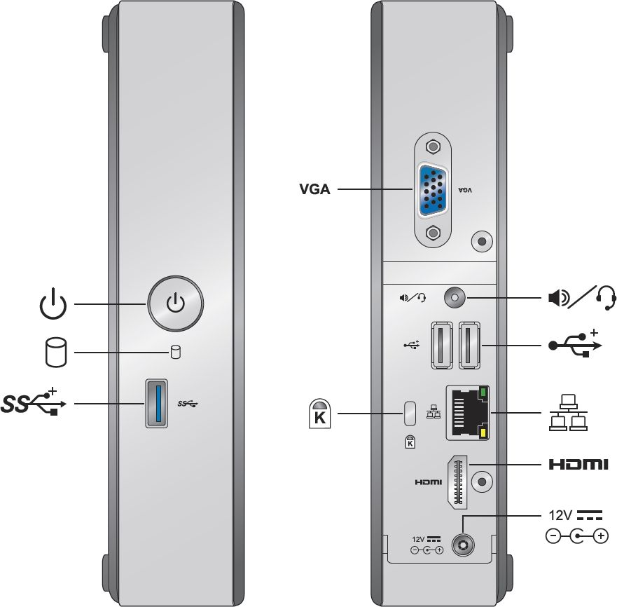
INTEL NUC DE3815TYKE

Slide 41
GALILEO BOARD

Slide 42
Raspberry Pi 3 PNG
https://commons.wikimedia.org/wiki/File:Raspberry_Pi_3_illustration.svg

Slide 43
RASPBERRY PI

Slide 46
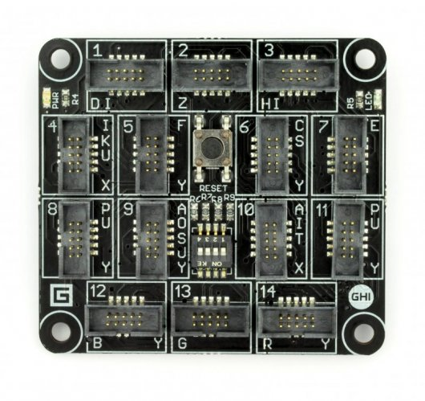
FEZ SPIDER MAIN BOARD

Slide 47
Sparkfun weather shield

Slide 48
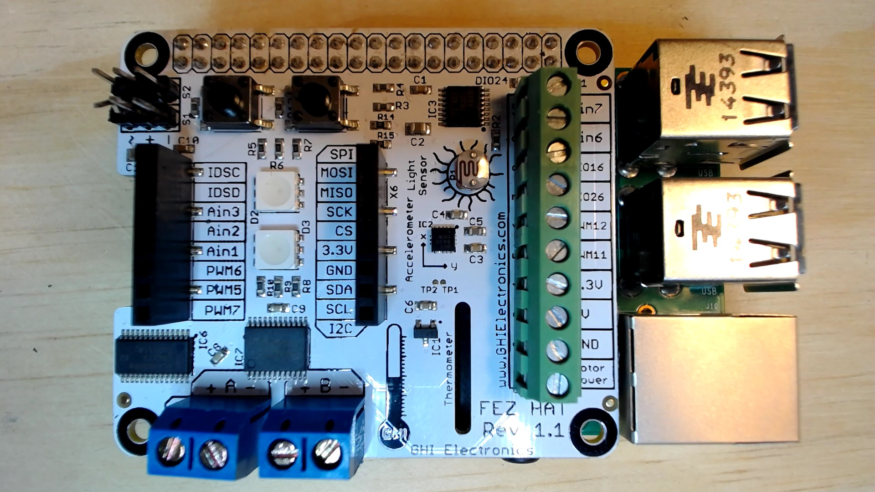
FEZ HAT

Slide 49
Device graphics from docs
Device with Filled Holes
Device with Through Holes
This is a version of the Device icon used in the “Extended IoT Scenarios” in docs. For example: https://docs.microsoft.com/en-us/azure/iot-hub/iot-hub-explorer-cloud-device-messaging

Slide 50
Connect the dots azure icons
Event Hubs
Stream Analytics
Storage
(
Azure
Microsoft Azure
Web App
Service Bus
)
Storage blob
Storage table
SQL database
HDInsight
Machine
(
Learning
GitHub code
Git repository
generic
)

Slide 51
cables

Slide 52
More cables and adapters

Slide 53

LEDs
Anode (+)
Cathode (-)
Flat Edge
Small Post
Big Post
Long Leg
Short Leg
Vcc (+)
GND

Slide 54
LEDs

Slide 55
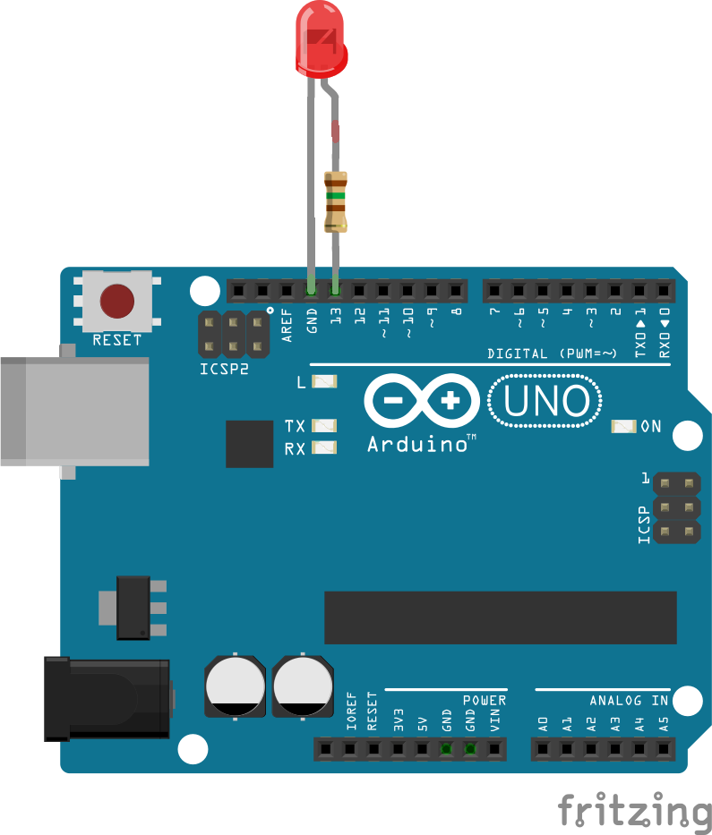




Current limiting resistors
Providing more current than an LED is rated for can destroy the LED. To prevent that, you should use a “Current Limiting” resistor.
To calculate the value of the resistor you need to know the supply voltage (Usually 5V on the Arduino Uno), and the LEDs rated Forward Voltage (the voltage drop across the LED) and Forward Current (the maximum current the LED can handle).
$$V_{f}=2Vdc I_{f}=20mA$$
$$Resistor Value (R)= \frac{Supply Voltage \left(V_{s}\right)−LED Forward Voltage (V_{f}) }{LED Forward Current (I_{f})}$$
$$V_{s}=5Vdc$$
$$R= \frac{V_{s} −V_{f}}{I_{f}} = \frac{5V−2V}{.02A} =150\text{Ω}$$
The Arduino Uno has a built in current limiting resistor on Pin 13. If you use Pin 13 to power your LED you can use it without a separate resistor.

Slide 56
Resistors
220Ω
1st Digit
2nd Digit
Multiplier
Tolerance
Color | Name | 1st Digit | 2nd Digit | Multiplier | Tolerance
 | Black | 0 | 0 | X1
 | Brown | 1 | 1 | X10 | 1%
 | Red | 2 | 2 | X100
 | Orange | 3 | 3 | X1,000
 | Yellow | 4 | 4 | X10,000
 | Green | 5 | 5 | X100,000
 | Blue | 6 | 6 | X1,000,000
 | Violet | 7 | 7
 | Grey | 8 | 8
 | White | 9 | 9
 | Gold |  |  | X0.1 | 5%
 | Silver |  |  | X0.01 | 10%
330Ω
10KΩ

Slide 57

Potentiometer – variable resistor

Slide 58
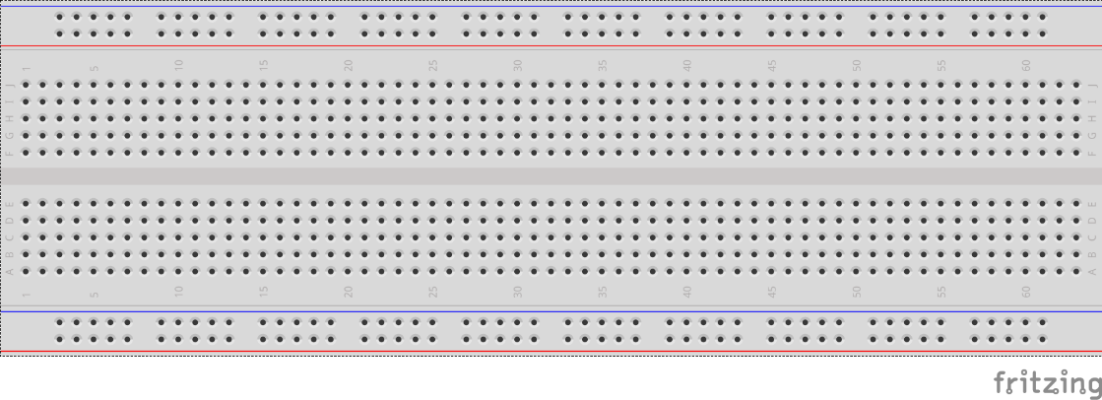
breadboards
Breadboards offer a great way to prototype circuits. The provide a number of “buses” for connecting both power and components.
Power buses run the entire horizontal length
Component buses give you easy ways to connect pins together

Slide 61
Micro SD Cards
Font: Segoe UI Semibold

Slide 62
